Slide 1
Mini Project: Automating Information Security - Log Analyzer
Yongning Tang

Slide 2
Outline
Threats to network services
What is a security log?
What is Apache Web Access Log?
What is a log analyzer? – the challenge
How to implement it!
Design
Regular expression
Dictionary and Counter Dictionary
File access
OOP design
GUI

Slide 3
Threats vs. Attacks
Threat
A potential for violation of security, which exists when there is a circumstance, capability, action, or event that could breach security and cause harm. That is, a threat is a possible danger that might exploit a vulnerability.
Attack
An assault on system security that derives from an intelligent threat. That is, an intelligent act that is a deliberate attempt (especially in the sense of a method or technique) to evade security services and violate the security policy of a system.

Slide 4
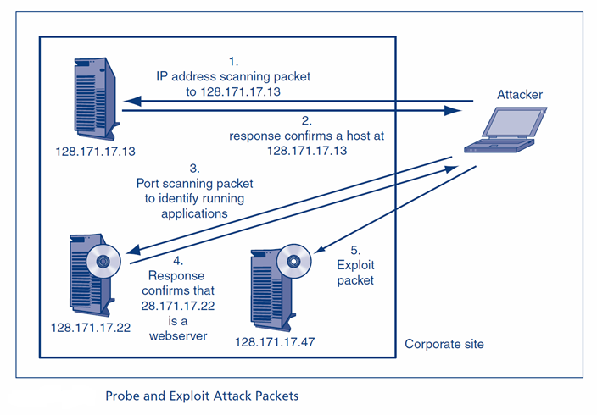
Probe and Exploit Attack Packets

Slide 5
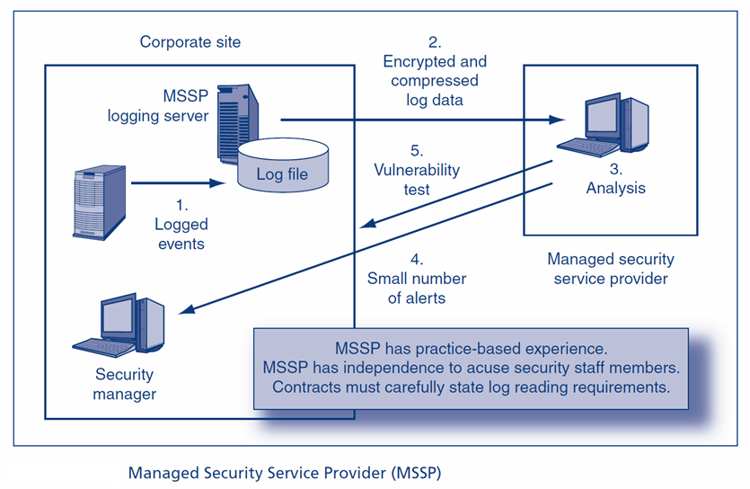
Managed Security Service Provider (MSSP)

Slide 6
What is a security log?
A security log is a log that contains records of login/logout activity or other security-related events specified by the system's audit policy.
The Security Log is one of the primary tools used by Administrators to detect and investigate attempted and successful unauthorized activity and to troubleshoot problems; Microsoft describes it as "Your Best and Last Defense".
Types of data logged
Web, Linux, OpenStack, VMWare access ; DNS query; etc.

Slide 7
Apache web access log: Common Log Format
The Common Log Format is a standardized text file format used by web servers when generating server log files.
Each line in a file stored in the Common Log Format has the following syntax: host ident authuser date request status bytes 127.0.0.1 user-identifier frank [10/Oct/2000:13:55:36 -0700] "GET /apache_pb.gif HTTP/1.0" 200 2326
127.0.0.1 is the IP address of the client (remote host) which made the request to the server.
user-identifier is the RFC 1413 identity of the client.
frank is the userid of the person requesting the document.
[10/Oct/2000:13:55:36 -0700] is the date, time, and time zone that the request was received, by default in strftime format %d/%b/%Y:%H:%M:%S %z.
"GET /apache_pb.gif HTTP/1.0" is the request line from the client. The method GET, /apache_pb.gif the resource requested, and HTTP/1.0 the HTTP protocol.
200 is the HTTP status code returned to the client. 2xx is a successful response, 3xx a redirection, 4xx a client error, and 5xx a server error.
2326 is the size of the object returned to the client, measured in bytes.

Slide 8
Another type of log: DNS Query Log
Data we might be interested in:
Querying client address
Resource record type queried
Resource record name queried

Slide 9
The development of log analyzer – the challenge
Handling large volume of data
Good data structures; big data processing engine and platform
Selecting/searching info/symptoms from the raw data
Understanding systems and networking technologies/protocols behind the data
Correlating symptoms to their root causes
Graphic Models; AI/ML

Slide 10
Tackling the challenges
Handling large volume of data
Good data structures - Counters
Selecting/searching info/symptoms from the raw data
Understanding systems and networking technologies/protocols behind the data - Regular Expression
Correlating symptoms to their root causes
Graphic Models; AI/ML – Future learning

Slide 11
Our web log (non standard format)
A sample line: 109.169.248.247 - - [12/Dec/2015:18:25:11 +0100] "GET /administrator/ HTTP/1.1" 200 4263 "-" "Mozilla/5.0 (Windows NT 6.0; rv:34.0) Gecko/20100101 Firefox/34.0" "-“
A log file can be easily hundreds of millions of lines
One of our log files is ~600MB. We take the first 10,000 lines for testing

Slide 12
Recap: regular expression
A regular expression is a string that defines a pattern to match other strings
They are highly efficient but difficult to read
Implemented in the Python “re” module >>> import re
Example: re.findall(‘regular expression’, ‘data to search’)

Slide 13
Python re functions()
.match(re, str): Start at the beginning of str and extract as much as you can
.search(re, str): Match anywhere in str
.match() and .search() return an object with the results in its .group() attribute
.findall(re, str): Find all occurrences in the string; return them in a list

Slide 14
Some common Regular Expression rules - using https://pythex.org/ to test
clientIP
timestamp
action

Slide 15
Recap: Dictionary
Lists are automatically indexed with an integer
With dictionaries, you specify a “key” as the index to a “value”
Unordered data structure where a given key produces its matching value
Key can be any immutable data type, e.g., integer, string, tuple
Value can be integer, string, list, another dictionary, etc.
Dictionaries are VERY FAST at storing and retrieving data

Slide 16
Specialized Dictionaries
The ‘collections’ module has several special-purpose dictionaries with modified behavior
OrderedDict: a dictionary that remembers the order keys were inserted
Defaultdict: a dictionary that enables you to specify a default value for undefined keys
Counter: a dictionary that automatically counts the number of times a key is set

Slide 17
Counter
Counter is a customized defaultdict that counts the instances of keys with a few useful methods: most_common(x), updata(), elements(), subtract()
>>>from collections import Counter >>>wordcount = Count() >>> wordcount.update( open(“anycontent.txt”).read().lower().split() ) >>>wordcount.most_common(10) [('cyber', 14), ('and', 12), ('to', 12), ('security', 10), ('the', 7), ('a', 6), ('what', 5), ('is', 5), ('that', 4), ('of', 4)] >>>wordcount[‘cyber’] 14 >>>wordcount.update([‘cyber’, ‘cyber’]) >>>wordcount[‘cyber’] 16 >>>wordcount.subtract([‘cyber’]) >>>wordcount[‘cyber’] 15

Slide 18
OOP – LogAnalyzer class
Fields
Methods

